Slide 1



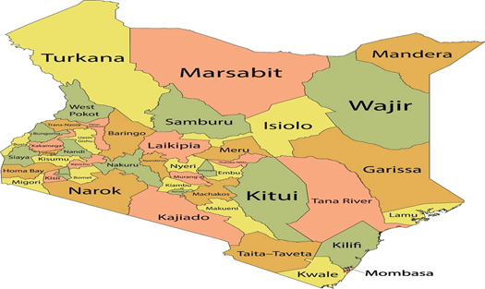
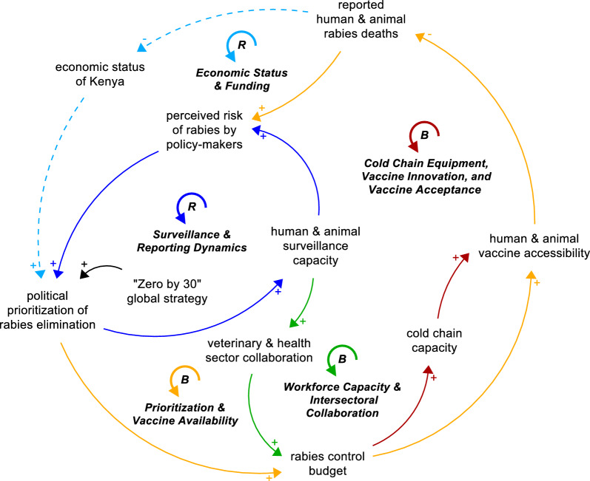


Towards “Zero by 30”: Exploration of Barriers To Rabies Policy Implementation in Kenya Through Systems Thinking
Laurent Smets¹*, Sanjeet Kumar Jaiswar¹, Valentijn Stienen¹, Benedict Mueke Muma², Vincent Okungu³, Nico Vandaele¹ and Catherine Decouttere¹
1: Access‑to‑Medicines Research Centre, Faculty of Economics and Business, KU Leuven, Leuven, Belgium. 2: Department of Health Services, Government of Makueni County, Makueni, Kenya. 3: Kenyatta National Hospital (KNH), Faculty of Health Sciences, Department of Public & Global Health, University of Nairobi, Nairobi, Kenya.
BACKGROUND
Rabies is a neglected tropical disease (NTD) that disproportionately affects marginalized communities.
The "Zero by 30" global strategic plan aims to eliminate dog-mediated human rabies deaths by 2030.
Kenya has adapted this plan into its Strategic Plan for Rabies Elimination, but systemic barriers persist.
Some challenges include underreporting, fragmented vaccine supply chains, insufficient governance, and reliance on donor funding particularly for settings in Kenya.
Stakeholders mapped barriers to rabies elimination using Group Model Building and Causal Loop Diagrams (CLD).
OBJECTIVE: To bridge critical gap in literature by examining the systemic obstacles Kenya faces in aligning its localized rabies-control approaches with the “Zero by 30” global objectives..
METHODOLOGY:
Approach/Design: Process: Interviews (34) → Field visits (5, Makueni) → GMB workshop (20) → CLDs. Frameworks: WHO Health System Building Blocks + Zero by 30 strategy. Ethics: Approved by KNH-UoN & KU Leuven. Outcome: Stakeholder‑validated CLDs mapping systemic barriers to rabies elimination.
STUDY AREA: Kisumu, Siaya, Machakos, Kitui, Makueni, Kenya
STUDY DESIGN: Mixed-methods systems dynamics (qualitative and participatory).
Sampling: Purposive for Government (13), NGOs (5), Academia(6), Not-for-profit R&D (1), Industry (2), intergovernmental agency (7)
DISCUSSION
Stronger economic status boosts funding, which improves surveillance, cold chain, workforce, and vaccine availability.
Better surveillance reveals true burden, raising policymakers’ risk perception and driving prioritization.
Adequate cold chain and innovation increase vaccine uptake and trust.
Skilled, coordinated teams across health and veterinary sectors strengthen campaigns.
Political prioritization ensures resources and vaccine supply; lack of prioritization leads to shortages and weak sustainability.
Fig. 1 Map of Kenya with Focused counties
STATISTICAL ANALYSIS:
Coding (NVivo) → Reflexive thematic analysis → CLDs (Stella Architect) → Validation (GMB)
RESULTS
Five key thematic groups of feed-back loops.
  Surveillance and reporting dynamics
  Prioritization and vaccine availability
  Economic status and funding
  Workforce capacity and intersectoral collaboration
  Cold chain equipment, vaccine innovation and vac-cine acceptance
CONCLUSIONS
Rabies elimination in Kenya is undermined by systemic barriers in funding, surveillance, and collaboration.
Systems thinking shows reinforcing loops can accelerate progress, while weak infrastructure and mistrust slow it down.
County Governments to invest in rabies surveillance and vaccines, strengthen intersectoral collaboration, and secure sustained funding to break systemic barriers to rabies elimination.
Fig. 2 Aggregated consolidated CLD showing reinforcing and balancing loops in Kenya’s rabies control system.
Contact: benedictmuma@gmail.com

